Slide 1
A Univariate Time Series Analysis for Turkey’s Covid-19 Cases
Presented by
Yusuf Kağan Özkan

Slide 2
OUTLINE
1) INTRODUCTION
2) EXPLORATORY DATA ANALYSIS
3) ARIMA
4) PROPHET
5) LSTM
6) HYBRID MODEL
7) TIME SERIES REGRESSION MODEL
8) MODEL SELECTION
9) DISCUSSION AND CONCLUSION

Slide 3
INTRODUCTION
This study aims to forecast future values and making interpretations about Turkey’s Covid-19 Cases.
March 2020 to May 2022

Slide 4
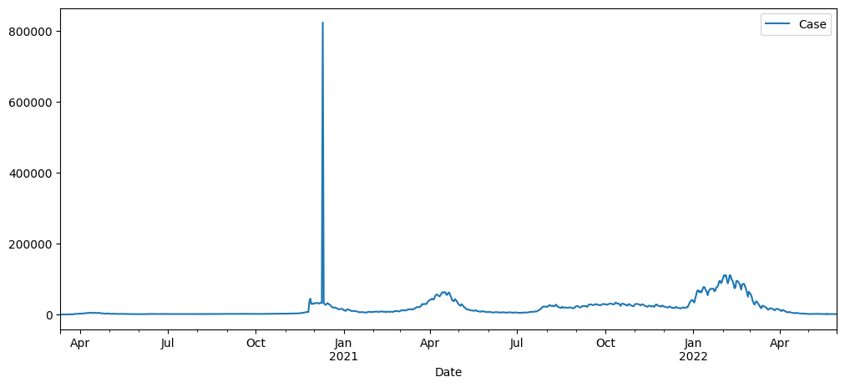
EXPLORATORY DATA ANALYSIS
Time Series Plot

Slide 5
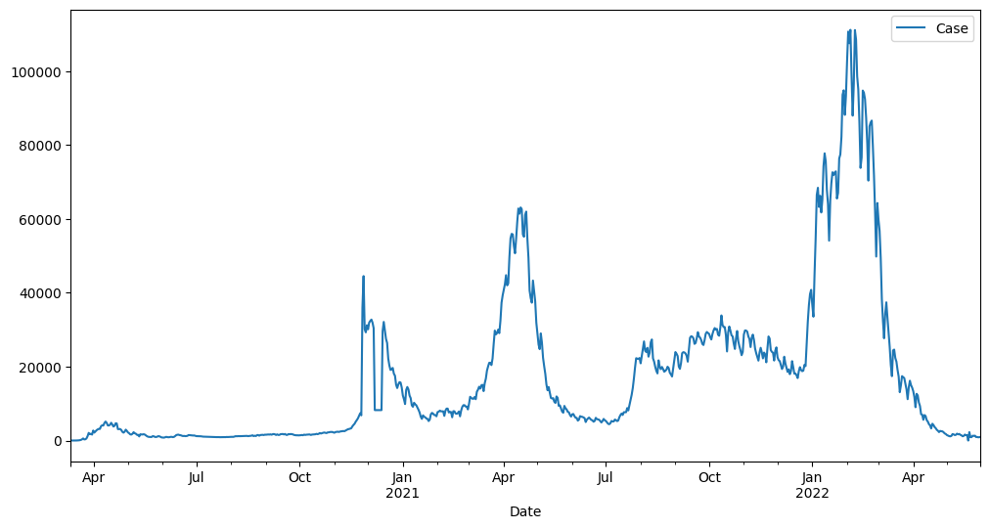
EXPLORATORY DATA ANALYSIS
Time Series Plot

Slide 6
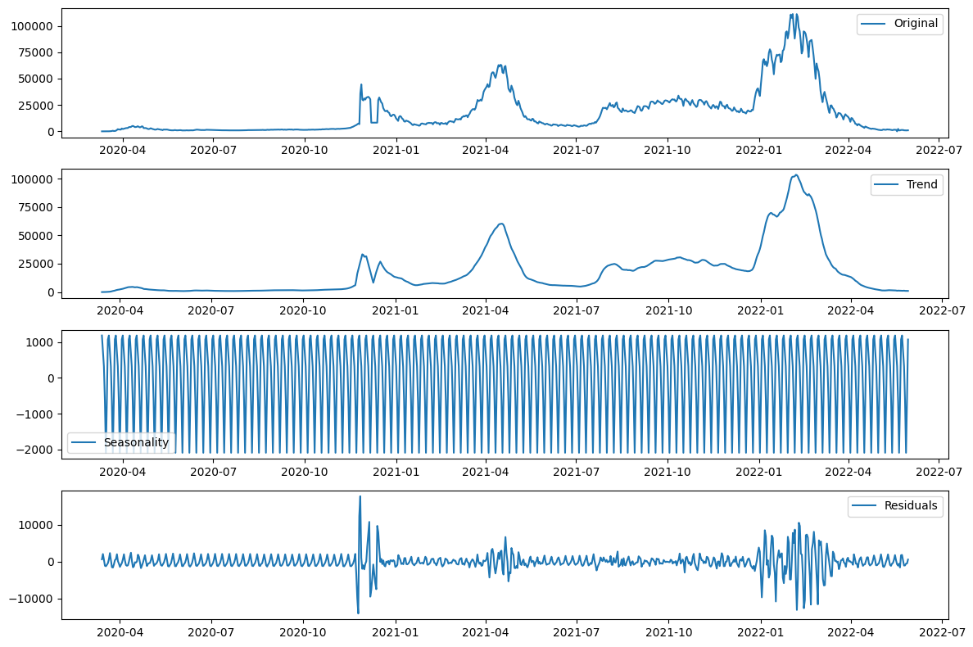
EXPLORATORY DATA ANALYSIS
Decomposition

Slide 7
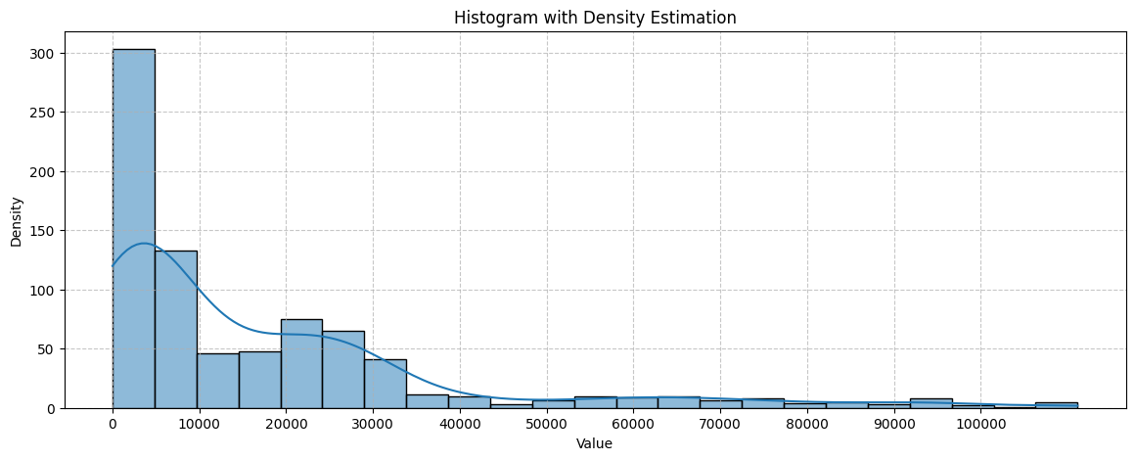
EXPLORATORY DATA ANALYSIS
Shape of the
variable of interest

Slide 8
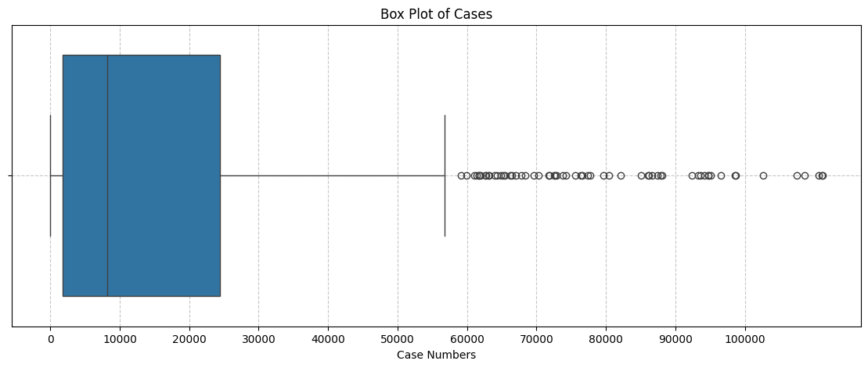
EXPLORATORY DATA ANALYSIS
Shape of the
variable of interest

Slide 9
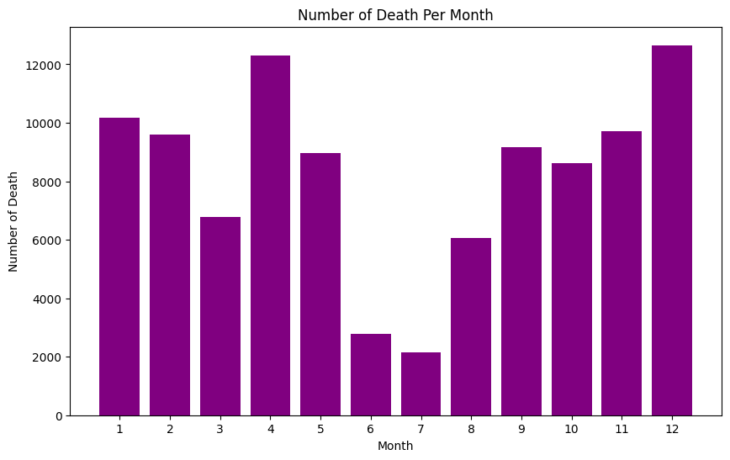
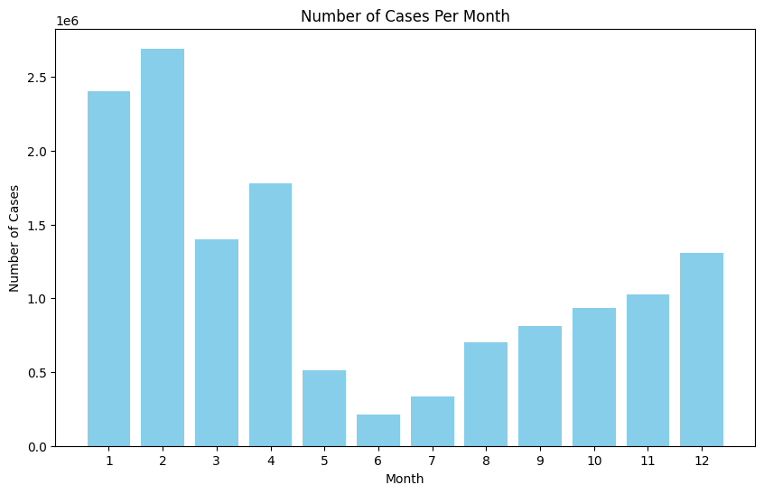
EXPLORATORY DATA ANALYSIS

Slide 10
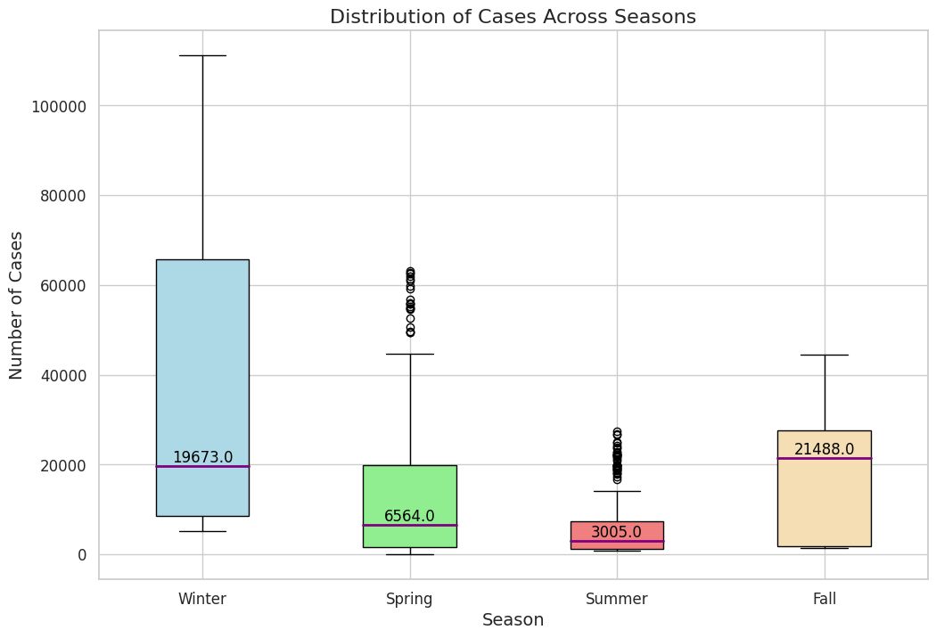
EXPLORATORY DATA ANALYSIS

Slide 11
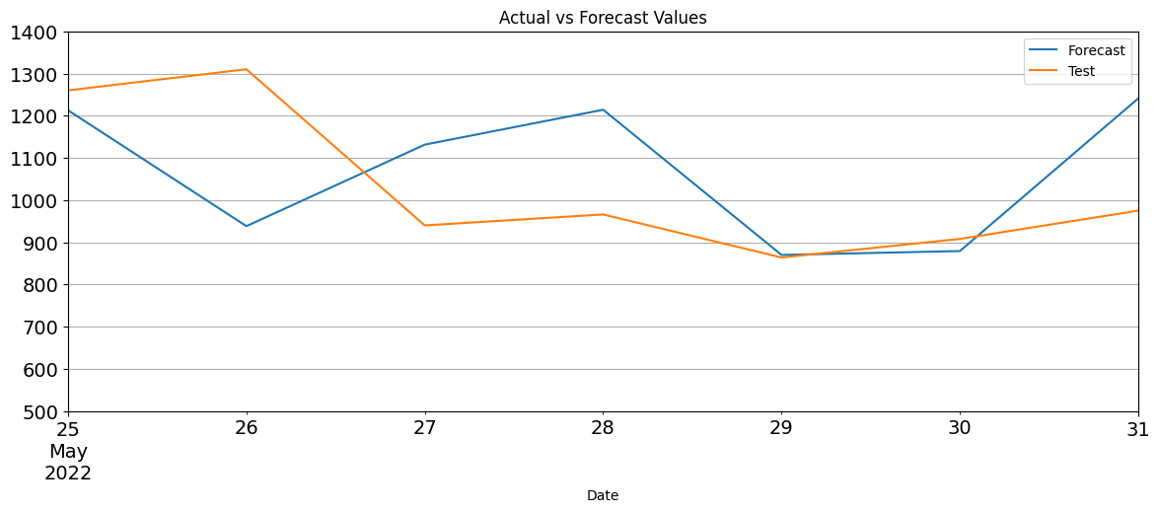
ARIMA
ARIMA(5,1,5)

Slide 12
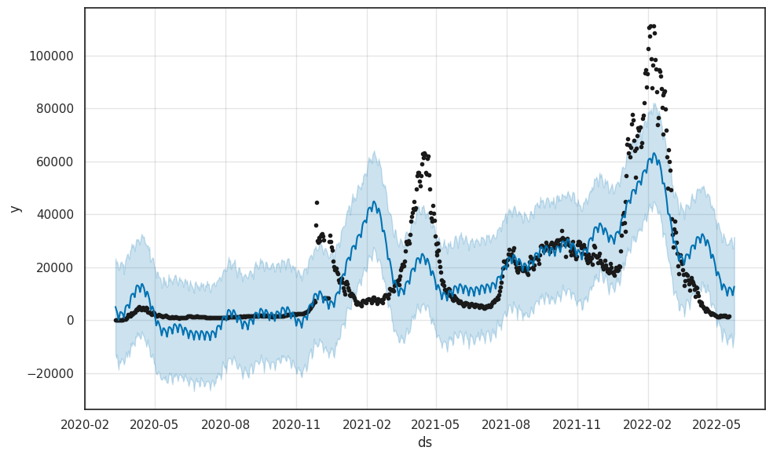
PROPHET

Slide 13
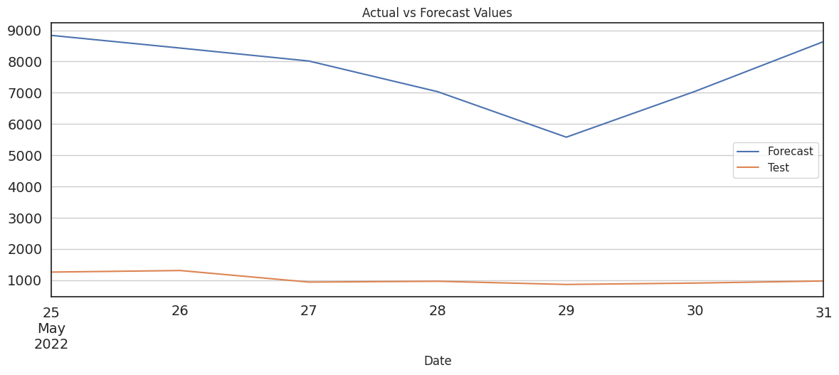
PROPHET

Slide 14
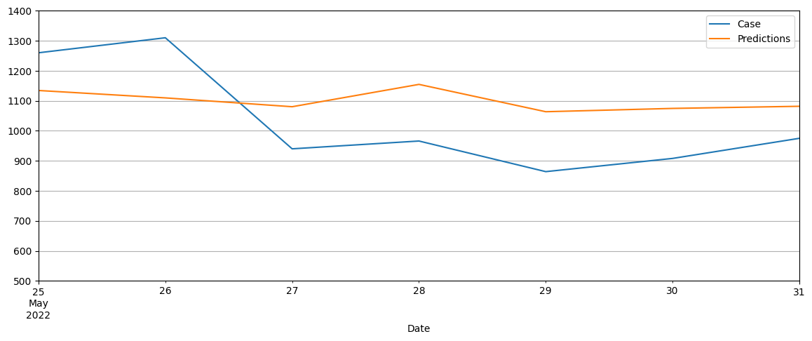
LSTM

Slide 15
HYBRID MODEL

Slide 16
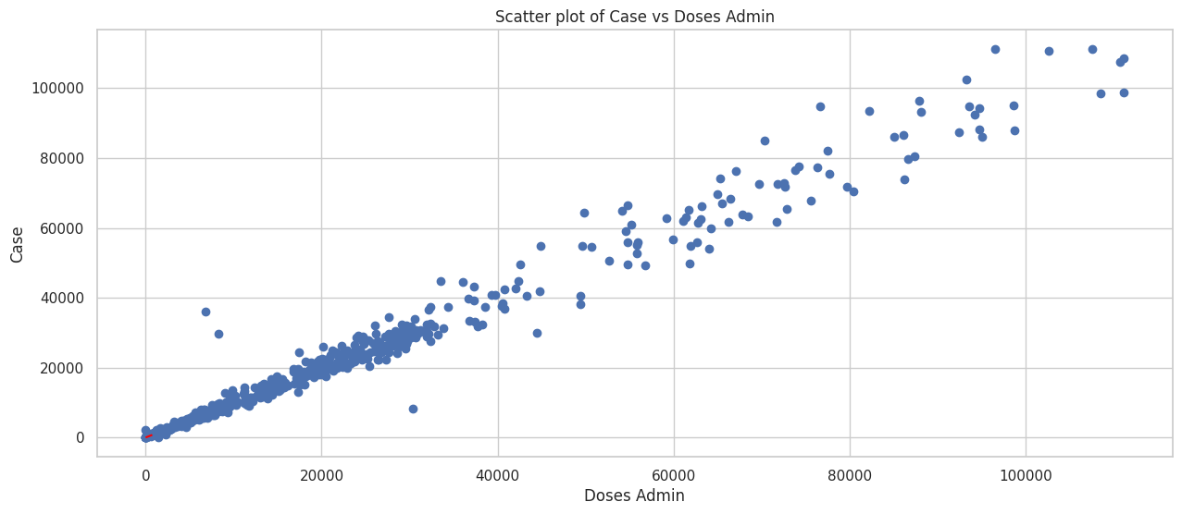
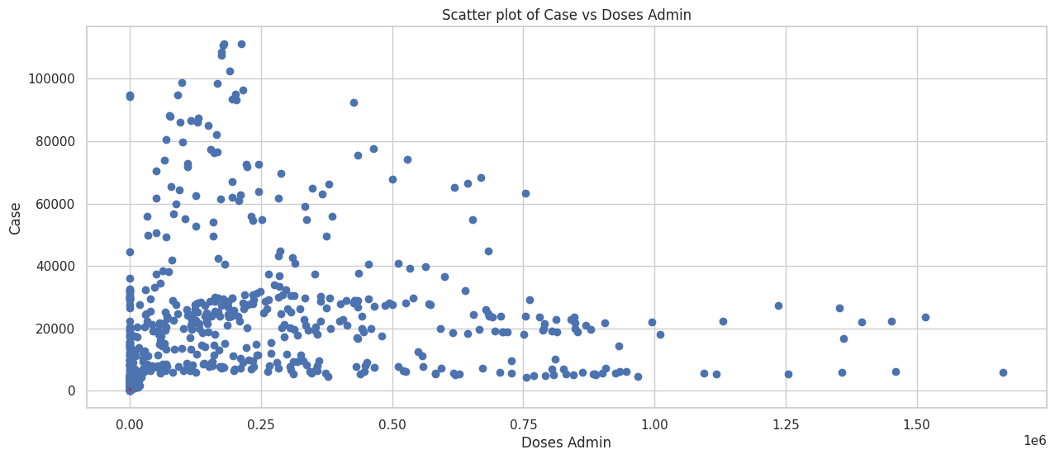
TIME SERIES REGRESSION MODEL
ŷ=-27.1557+0.9868(Case.L1)+
0.0014(Doses_admin)
Adj. R-squared: 0.980
Durbin-Watson: 1.58

Slide 17
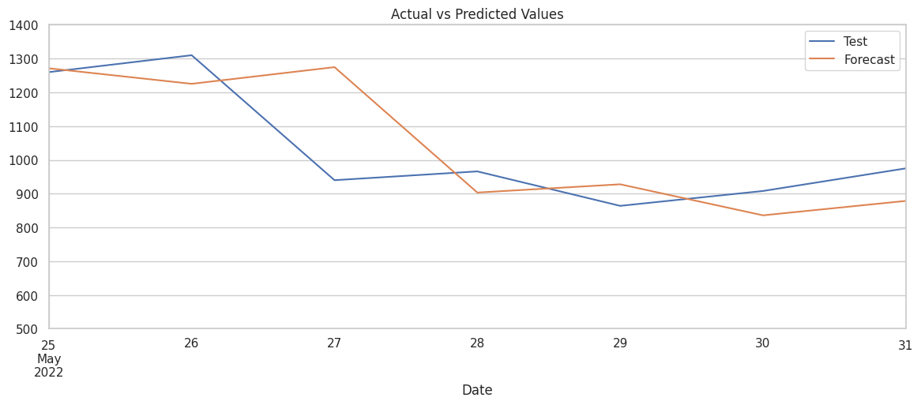
TIME SERIES REGRESSION MODEL

Slide 18
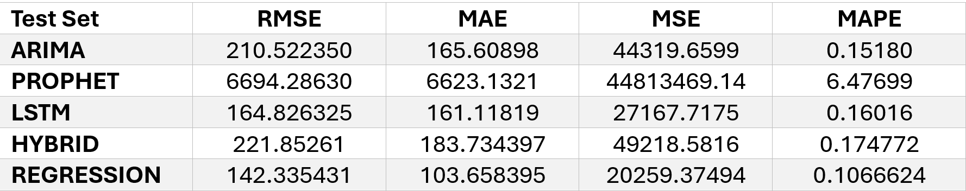
MODEL SELECTION
Test Set Accuracy Measures

Slide 19
DISCUSSION AND CONCLUSION
Regression
LSTM

Slide 20
References
Devaraj, J., Elavarasan, R. M., Pugazhendhi, R., Shafiullah, G. M., Ganesan, S., Jeysree, A. K., ... & Hossain, E. (2021).
Forecasting of COVID-19 cases using deep learning models: Is it reliable and practically significant?. Results in Physics, 21, 103817.
Yusuf, S. (2022, Oct 24). Linear regression with time series data. Medium.
https://medium.com/@sawsanyusuf/linear-regression-with-time-series-data-9186eb1ee607
Keith, M. (2022). Exploring the LSTM neural network model for time series. Towards Data Science. https://towardsdatascience.com/exploring-the-lstm-neural-network-model-for-time-series-8b7685aa8cf

